Slide 1


The Greedy Algorithm for Shortest Superstrings
Information Processing Letters 93(2005) 13-17
Haim Kaplen, Nira Shafrir
Presenter: Chiao-Wei Chiu (邱喬偉)
Date: Oct. 19, 2006

Slide 2
Introduction
Despite a considerable progress achieved since the work of Blum et al. on designing approximation algorithms other than GREEDY with better approximation guarantees, there has been no progress since on narrowing the gap regarding the approximation guarantee of GREEDY.
Many of the approximation algorithms for the superstring problem are more complicated and less efficient than GREEDY.
This makes it important to know whether the approximation ratio of GREEDY is in fact better than that of the other approximation algorithms.
In this paper we prove that the string produced by GREEDY is in fact within a factor of 3.5 from the optimal string.
To get this result, we use the "overlap-rotation lemma" of Breslauer, Jiang T. and Jiang Z., to tighten the upper bound on the total length of the so-called "culprit bad back edges" in the proof of Blum et al.

Slide 3
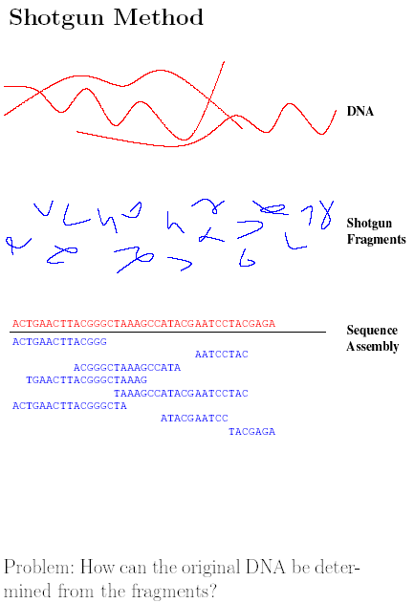
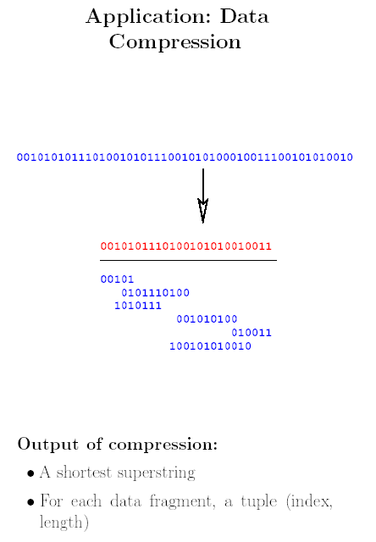
出處

Slide 4
Shortest Superstring Problem
Input:
ABRAC
ACADA
ADABR
DABRA
RACAD
Output:
ABRACADABRA
------------------
ABRAC
RACAD
ACADA
ADABR
DABRA

Slide 5
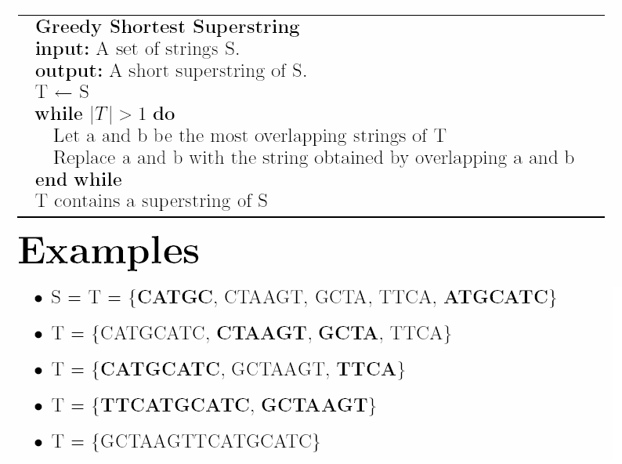
Greedy Algorithm

Slide 6
Overlap & Prefix
overlap(s_{i}, s_{j}): The longest overlap between s_{i} and s_{j}
prefix(s_{i}, s_{j}): First letters of s_{i} where overlap(s_{i}, s_{j}) is removed
        i ACGGCTAT....
        j ....CTATTAGC
        overlap CTAT
        prefix ACGG

Slide 7
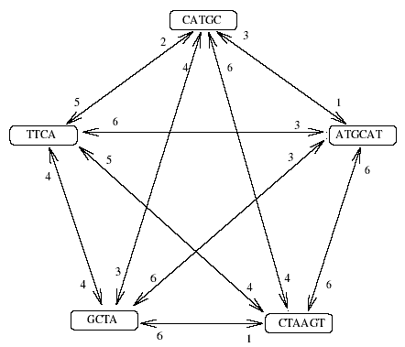
Prefix Graph
G_{S} = (V, E, w) is a complete directed graph. V is {s₁,s₂,…,s_{n}}
d(s_{i}, s_{j}) =｜prefix(s_{i}, s_{j})｜
Let c be a cycle in G_{S}
w(c) = the weight of c

Slide 8
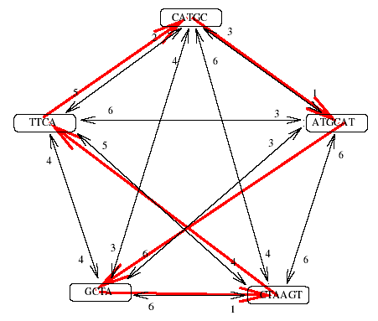
TSP
Let the shortest superstring be t, then
t = prefix(s₁,s₂)。prefix(s₂,s₃)。...。prefix(s_{n},s₁)。overlap(s_{n},s₁)
Let c = s₁, s₂, s₃, ... ,s_{n}
OPT(S) =｜t｜= w(c) +｜overlap(s_{n},s₁)｜
For example:
t TCRAAGTTCATGCATC
1 TCTA............
2 .CTAAGT.........
3 ......TTCA......
4 ........CATGC...
5 .........ATGCATC
.............TCTA
w(c) = TSP(G_{s}) ≦OPT(S)

Slide 9
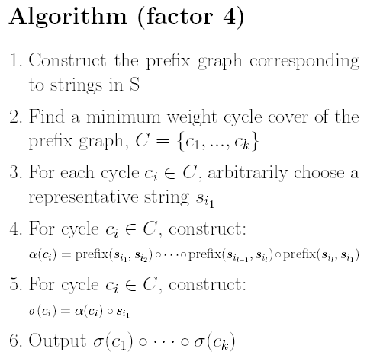

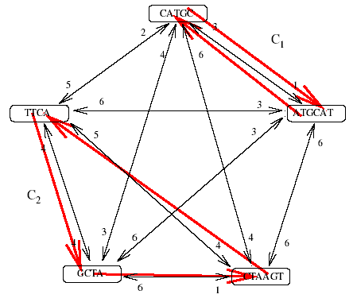
Cycle Cover
CCP(G_{s}) ≦ TSP(G_{s}) ≦ OPT(S)

Slide 10
Culprits
culprit [i, j] = string <s_{i}, s_{i+1}, ... , s_{j-1}, s_{j}> that overlap(s_{i}, s_{j}) is min
Let S_{m} be the set of all strings that belong to culprits
Let C_{m} be the cycle cover over S_{m}
w_{C} = weight of C_{m} ≦OPT(S_{m}) ≦OPT(S)
o_{C} = the sum of the overlaps of all edge

Slide 11
Bound of Greedy
Blum et al.[3] showed that the string t produced by GREEDY is
|t| ≦ 2OPT(S) + o_{C} – w_{C}
To get the 4-approximation they used inequality to bound o_{C}. They showed that
o_{C} ≦ OPT(S)+2w_{C}
We get our result by proving that
o_{C} ≦ OPT(S)+1.5w_{C}
A bound of 3.5 on the approximation ratio

Slide 12
Reference
[1] Armen C., Stein C., Improved length bounds for the shortest superstring problem, Proc. 4th Internat. Workshop on Algorithms and Data Structures (WADS), (1995), pp. 494--505
[2] Armen C., Stein C., A 2 2/3-approximation algorithm for the shortest superstring problem, Proc. 7th Annual Symp. on Combinatorial Pattern Matching (CPM), (1996), pp. 87--101
[3] Blum A., Jiang T., Li M., Tromp J., Yannakakis M., Linear approximation of shortest superstring, J. ACM, Volume: 31, Issue: 4 (1994), pp. 630--647
[4] Breslauer D., Jiang T., Jiang Z., Rotations of periodic strings and short superstrings, J. Algorithms, Volume: 24, Issue: 2 (1997), pp. 340--353 Bibliographic Page Full text
[5] Czumaj A., Gasieniec L., Piotrw M., Rytter W., Sequential and parallel approximation of shortest superstrings, J. Algorithms, Volume: 23, Issue: 1 (1997), pp. 74--100 Bibliographic Page Full text
[6] Kaplan H., Lewenstwein M., Shafrir N., Sviridenko M., Approximation algorithms for asymmetric tsp by decomposing directed regular multigraphs, Proc. 44th Annual IEEE Symp. on Foundations of Computer Science (FOCS), (2003), p. 56
[7] Kosaraju S.R., Park J.K., Stein C., Long tours and short superstrings, Proc. 35th Annual Symp. on Foundations of Computer Science (FOCS), (1994), pp. 166--177
[8] Sweedyk Z., -approximation algorithm for shortest superstring, SIAM J. Comput., Volume: 29, Issue: 3 (2000), pp. 954--986
[9] Teng S.H., Yao F., Approximating shortest superstrings, SIAM J. Comput., Volume: 26, Issue: 2 (1997), pp. 410--417
[10] Zaritsky A., Sipper M., The preservation of favoured building blocks in the struggle for fitness: the puzzle algorithm, IEEE Trans. Evolutionary Comput., Volume: 8, Issue: 5 (2004),

